Slide 1
XYZ University Network
MLB_WD_CSNE_01.01_11
IE1020 – Network Fundamentals
W M G V Weerasekara

Slide 2
Team Members
Student Name
Weerasekara W. M. G. V.
Bandara K. M. D. I.
Hettiarachchi K. A. U.
Wijegunawardana W. A. D. D. D.

Slide 3

Table of Content
Introduction.
Topology diagrams.
Real world network devices.
IP addressing schema.
Protocols.
Media types.
LAN and WAN technologies.
Security.
References.
Q & A.

Slide 4
Introduction
This is a network designed for XYZ University with 7 branches located throughout the country.
This network is designed to accommodate 50,000 hosts.
Colombo Branch holds the IT Department, which maintains the whole campus network.
The Main Branch is situated in the city of Colombo.
University's IT Department is responsible for maintaining the network infrastructure for all the branches of the campus.

Slide 5

Topology Diagrams

Slide 6
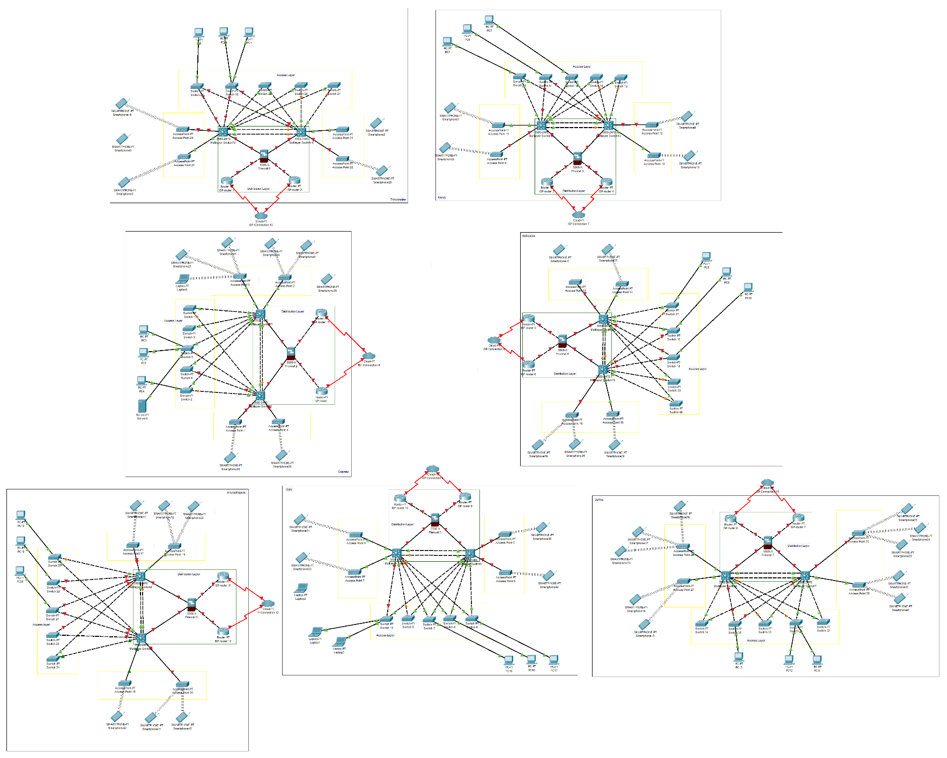
Logical Topology Diagram

Slide 7
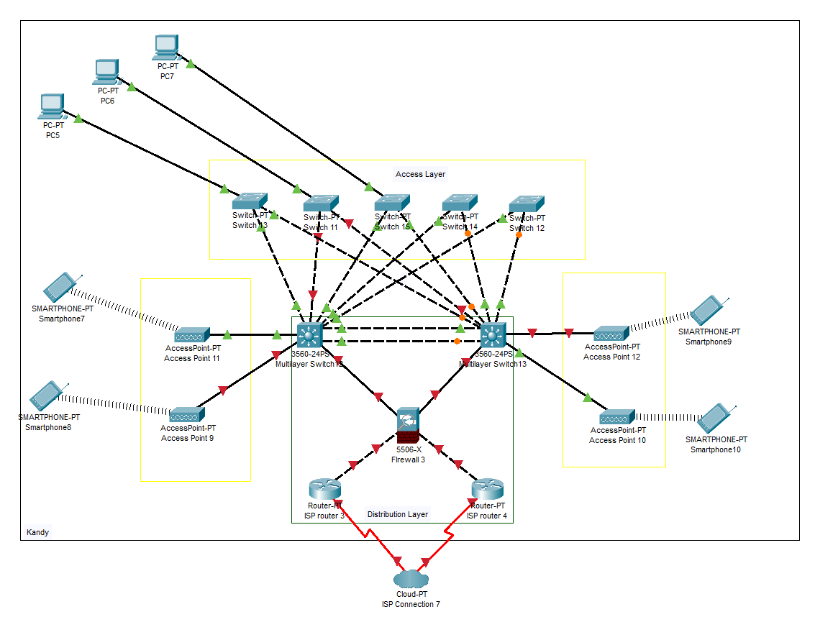
Logical Topology Diagram – Single Branch
Access Points located across the campus provides Wi-Fi connectivity to authenticated devices.
Included for clarity

Slide 8
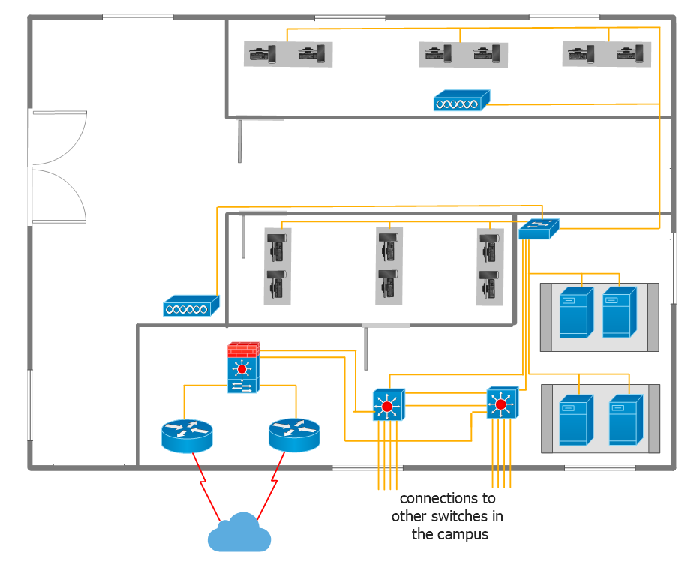
Physical Topology Diagram
Floor plan of IT Department

Slide 9
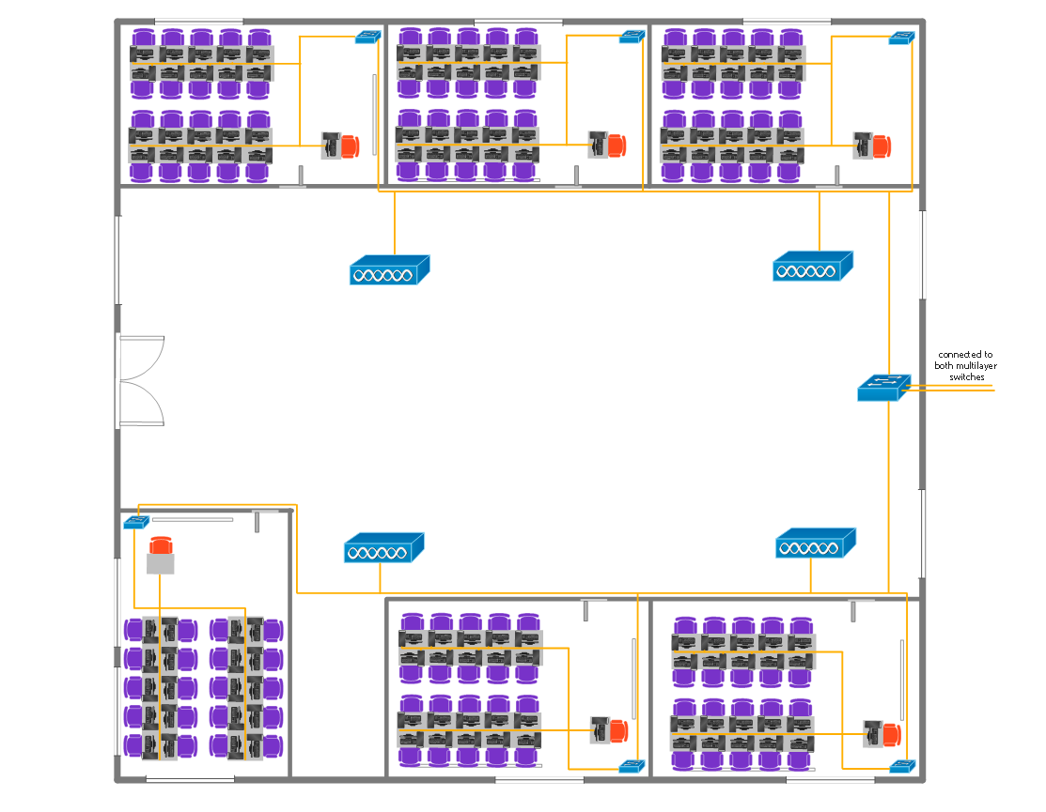
Computer Labs
Student Lounge
Floor plan of a building
Computer Labs

Slide 10

Real World
Network
Devices

Slide 11
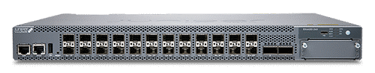
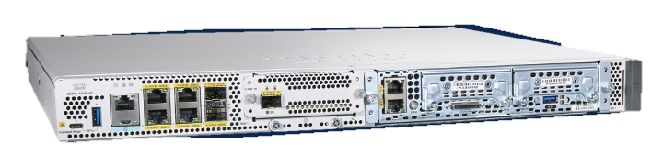
Multilayer Switch – Juniper EX4400-24X
Provides high scalability and low latency.
Provides faster data transfer speeds.
Improve efficiency and security.
Redundant power supplies to maintain uninterrupted operations. [1]
Router – Cisco Catalyst 8300 Series
Use to facilitate 5G SD-WAN.
Dual power supplies for fault tolerance.
High-performance multicore processors support high-speed WAN connections. [2]

Slide 12
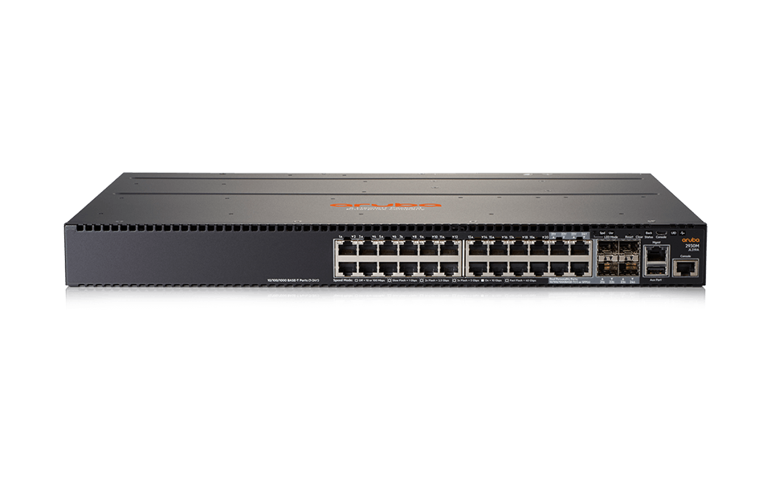

Switch – Aruba 2930M 40G R0M67A
Modular, flexible 10 Gbps Ethernet connectivity.
Increases the scalability of an Ethernet network by providing a hierarchical structure.
Traffic prioritization (IEEE 802.1p) for real-time classification into eight priority levels mapped to eight queues. [3]
Access Points – Aruba 503 series
Supports a wide variety of IEEE 802.11 up to 802.11ax standard devices.
Wi-Fi 6 coverage with 1.49 Gbps maximum real-world speed.
Two Ethernet wired network ports helps to connect to different switches which would allow for increasing fault tolerance. [4]

Slide 13
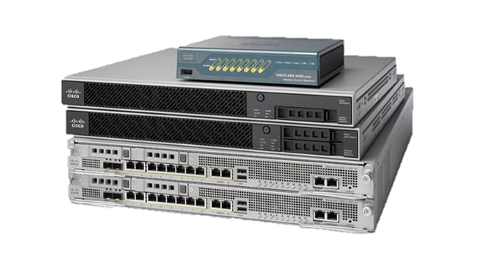
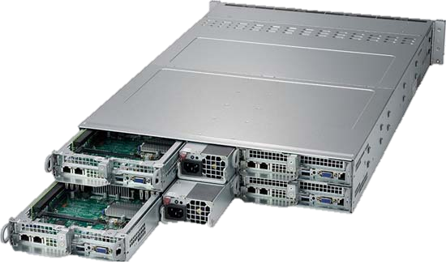
Firewall – Cisco Adaptive Security Appliance Firewall (ASA)
Helps organizations increase capacity and improve performance.
Meets the unique needs of both the network and the data center.
Offers integrated IPS, VPN, and Unified Communications capabilities.
Adds security to the network. [5]
Server – Supermicro SuperServer 2014TP - HTR
Optimized balance of compute, memory, I/O, and storage resources.
Providing up to 64 cores, 4TB of memory, and 128 lanes of PCIe 4.0 connectivity.
Clip-in slide rails, pre-configured RAID, and pre-installed OS offer easy installation. [6]

Slide 14

Backup Service - Backblaze Business Backup
Provides customers with a broad variety of options for restoring data.
Unlimited storage included.
Convenient hard-drive-by-mail recovery option.
Low-impact backup app runs in the background.
Easy integration with Backblaze B2 cloud storage. [7] [27]

Slide 15

IP Address Range & VLSM

Slide 16
Private IP Address Range
Class B Private IP address range
172.16.0.0 – 172.31.255.255
Class A address range is too large.
It will waste a large amount of IP addresses.
Class C is too small.
It is not sufficient to accommodate the required amount of IP addresses.

Slide 17
IP Addressing Schema (with VLSM)
Branch | Number of Hosts | Network Address | Usable Address IP Range | Broadcast Address
Colombo (Main) | 30100 | 172.16.0.0/17 | 172.16.0.1/17 - 172.16.127.254/17 | 172.16.127.255/17
Kandy | 8500 | 172.16.128.0/18 | 172.16.128.1/18 - 172.16.191.254/18 | 172.16.191.255/18
Galle | 8000 | 172.16.192.0/19 | 172.16.192.1/19 - 172.16.223.254/19 | 172.16.223.255/19
Jaffna | 1400 | 172.16.224.0/21 | 172.16.224.1/21 - 172.16.231.254/21 | 172.16.231.255/21
Anuradhapura | 950 | 172.16.232.0/22 | 172.16.232.1/22 - 172.16.235.254/22 | 172.16.235.255/22
Trincomalee | 800 | 172.16.236.0/22 | 172.16.236.1/22 - 172.16.239.254/22 | 172.16.239.255/22
Batticaloa | 250 | 172.17.240.0/24 | 172.16.240.1/24 - 172.16.240.254/24 | 172.16.240.255/24

Slide 18

Protocols

Slide 19
Application Layer
SMTP – To send and receive e-mails over internet. [8]
FTP – To send files through the network. [8]
DNS – To translate domain names into IP addresses. [8]
DHCP – To configure network devices to communicate on an IP network. [8]
Presentation Layer
SSL – Ensures the data that is transferred between client & server remains private. [9]
NCP – used to access file, print, directory, clock synchronization, messaging, remote command execution and other network service functions [9]

Slide 20
Session Layer
RTCP – To monitor data delivery on multicasting. [10]
SCP – Allows the server and client to have multiple connections over a single TCP connection. [11]
PAP – Password-based authentication. [10]
Transport layer
TCP – Enables applications and devices to exchange messages over a network. [12]
UDP – To prioritize time sensitive transmissions. (E.g. : DNS lookup) [13]
Network Layer
IP – Allows data packets to travel through the network to arrive at correct destination. [14]
ICMP – Network diagnostic and error reporting is done by this protocol. [15]
ARP – Used to discover MAC addresses associated with IP addresses. [15]

Slide 21
Data Link Layer
PPP – To connect one computer system to another. [16]
STP – Used to prevent looping within a network topology. [17]
IEEE 802.1X (NAC) – To ensuring that only authorized devices can connect to the network. [18]
Physical layer
IEEE 802.3 (Ethernet) – To create local area networks. [19]
DSL – To transmit digital data over telephone lines. [20]
IEEE 802.11 (Wi-Fi) – Refers to the set of standards that define communication for wireless LANs. [21]

Slide 22
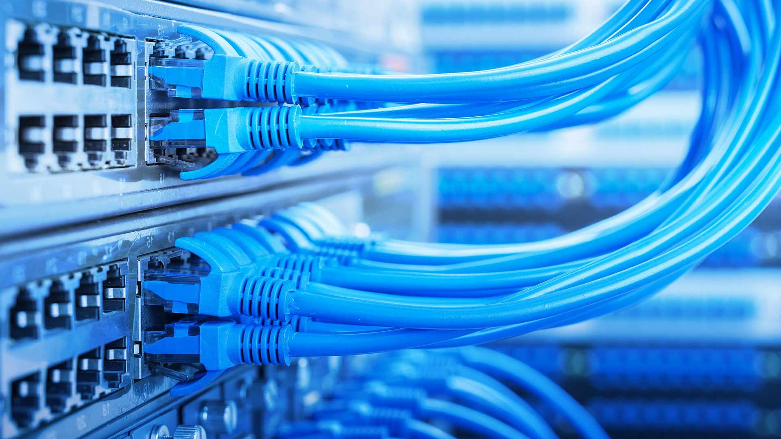
Media Types

Slide 23
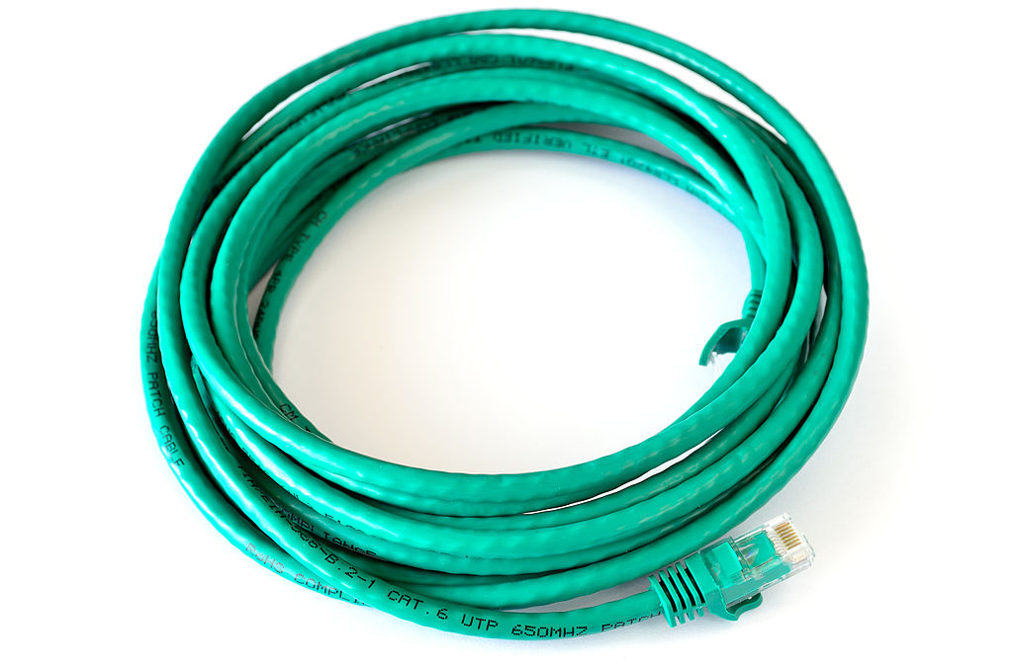
Wired Media
Cat6 Ethernet Cables
Perform up to 250 MHz which is more than twice that of CAT5e cables.
Offer speeds up to 10-Gigabit Ethernet.
Provide significantly lower interference (Near-End Crosstalk).
Improves Equal-Level Far-End Crosstalk (ELFEXT), Return Loss (RL), and Insertion Loss. (IL)
The result is less system noise, fewer errors and higher data transmission rates. [22] [23]

Slide 24
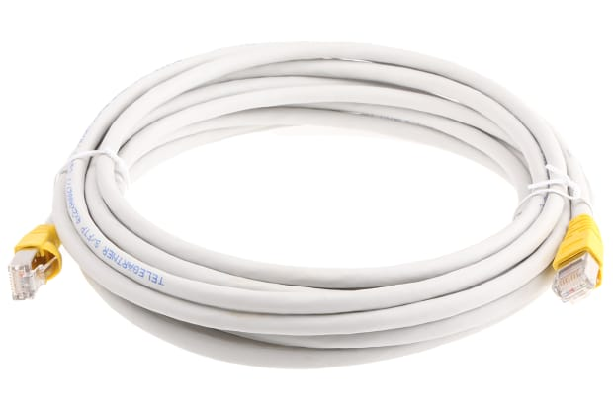
Cat7 Ethernet Cables
Designed to support 10 Gbps Ethernet.
Cabling runs must be able to support frequencies (bandwidth) of up to 600 MHz over 100m of copper wire.
Widely used across several industries demanding high performance networking and data transfer infrastructure.
They can also to withstand a broad range of environmental and mechanical hazards.

Slide 25
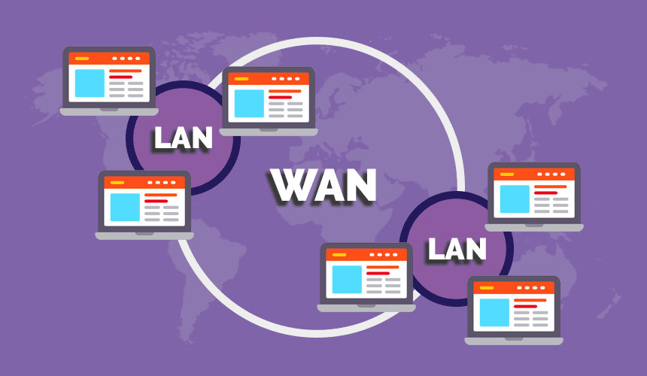
LAN & WAN Technologies

Slide 26
WAN Technology
Software Defined Wide Area Network (SLT Mobitel)
Cost efficient.
Increased bandwidth efficiency.
Enhances network performance.
Maintained by SLT Mobitel, which also makes the network futureproof. [24] [25]

Slide 27
LAN Technologies
Gigabit Ethernet
Speeds up to 10 Gbps.
Reduced latency from 5 – 20 milliseconds.
Supports high – speed internet and multiple devices. [26]
EtherChannel
A port link aggregation technology in which multiple physical port links are grouped into one logical link.
It is used to provide high-speed links and redundancy.
It is also known as Link Aggregation Control Protocol (LACP). [29]
In this scenario, it is used to connect the separate floors of budlings via a backbone connection.

Slide 28

Security

Slide 29
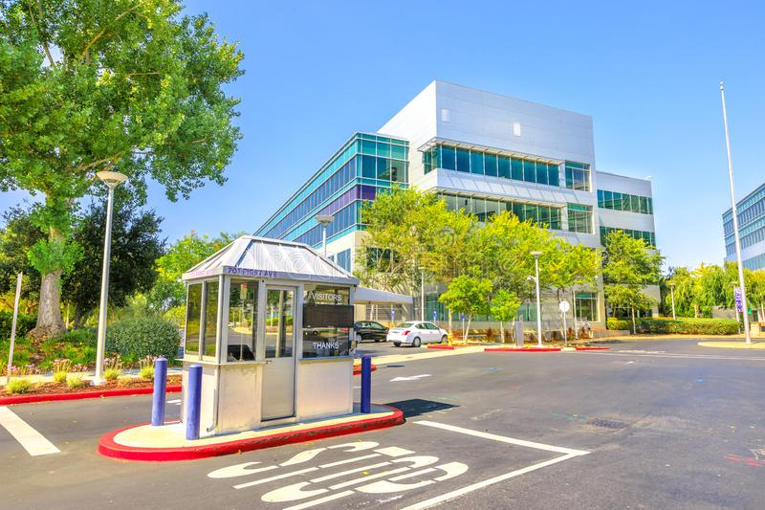
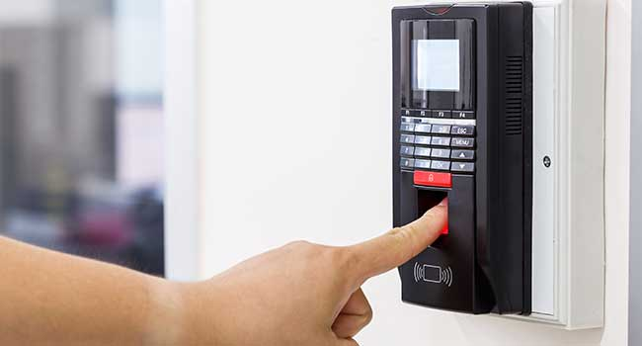
Physical Security
The campus branches have security guards and check posts at every entrance.
Only the students and authorized personnel are allowed to enter the campus premises.
The IT Department is only accessible by providing the registered fingerprints and students are not allowed to enter.
All the switch closets, server rooms, and racks are locked, and they are only accessible for authorized personnel.

Slide 30


Network Security
The campus network is protected by Cisco ASA Software Firewalls.
It allows collaboration with any type of device and allows dynamic routing. [5]
The whole network is backed up using Backblaze B2 Backup Service.
This service allows many forms of restoration methods and has unlimited storage, which is well suited for a large campus. [27]

Slide 31

References

Slide 32
[1] “EX4400-24X Ethernet Switch | Juniper Networks US,” www.juniper.net. https://www.juniper.net/us/en/products/switches/ex-series/ex4400-24x-ethernet-switch.html
[2] “Cisco Catalyst 8300 Series Edge Platforms Data Sheet,” Cisco. https://www.cisco.com/c/en/us/products/collateral/routers/catalyst-8300-series-edge-platforms/datasheet-c78-744088.html?oid=dstetr023050
[3] “Aruba 2930M Switch Series,” Aruba, 2017. https://www.arubanetworks.com/products/switches/access/2930m-series/#specs
[4] “Aruba 503 Series Indoor Access Points,” Aruba, 2013. https://www.arubanetworks.com/products/wireless/access-points/indoor-access-points/503-series/
[5] Cisco, “Cisco Adaptive Security Appliance (ASA) Software,” Cisco, Mar. 2019. https://www.cisco.com/c/en/us/products/security/adaptive-security-appliance-asa-software/index.html
[6] “Supermicro SuperServer 2014TP-HTR (AS-2014TP-HTR) - Configure,” www.broadberry.com. https://www.broadberry.com/superservers-supermicro-servers/sys-2014tp-htr
[7] “The Best Cloud Backup Services for Business,” PCMAG. https://www.pcmag.com/picks/the-best-cloud-backup-services-for-business
[8] “Protocols in Application Layer - GeeksforGeeks,” GeeksforGeeks, Aug. 2017. https://www.geeksforgeeks.org/protocols-application-layer/
[9] A. Singla, “Presentation Layer in OSI model,” GeeksforGeeks, Jul. 05, 2021. https://www.geeksforgeeks.org/presentation-layer-in-osi-model/

Slide 33
[10] “Session Layer in OSI model,” GeeksforGeeks, Jul. 10, 2021. https://www.geeksforgeeks.org/session-layer-in-osi-model/
[11] “Session Control Protocol (SCP),” www.w3.org. https://www.w3.org/Protocols/HTTP-NG/http-ng-scp.html#:~:text=SCP%20is%20a%20simple%20protocol
[12] “What is Transmission Control Protocol TCP/IP Model?,” Fortinet. https://www.fortinet.com/resources/cyberglossary/tcp-ip#:~:text=What%20is%20TCP%3F
[13] Cloudflare, “What is UDP? | Cloudflare UK,” Cloudflare. Available: https://www.cloudflare.com/en-gb/learning/ddos/glossary/user-datagram-protocol-udp/
[14] Cloudflare, “What is the Internet Protocol? | Cloudflare,” Cloudflare. Available: https://www.cloudflare.com/learning/network-layer/internet-protocol/
[15] “DCN - Network Layer Protocols - Tutorialspoint,” www.tutorialspoint.com. https://www.tutorialspoint.com/data_communication_computer_network/network_layer_protocols.htm
[16] “Point-to-Point Protocol (PPP),” www.tutorialspoint.com. https://www.tutorialspoint.com/point-to-point-protocol-ppp
[17] “What is Spanning Tree Protocol?,” Networking. https://www.techtarget.com/searchnetworking/definition/spanning-tree-protocol#:~:text=What%20is%20STP%20and%20how
[18] “What is 802.1X Network Access Control (NAC)? | Juniper Networks US,” www.juniper.net. https://www.juniper.net/us/en/research-topics/what-is-802-1x-network-access-control.html#:~:text=802.1X%20protocol%E2%80%94An%20IEEE

Slide 34
[19] “What Is IEEE 802.3?,” LiveAction. https://www.liveaction.com/glossary/ethernet-ieee-802-3/
[20] “Digital subscriber line,” Wikipedia, Feb. 22, 2021. https://en.wikipedia.org/wiki/Digital_subscriber_line
[21] Wikipedia Contributors, “IEEE 802.11,” Wikipedia, Aug. 28, 2019. https://en.wikipedia.org/wiki/IEEE_802.11
[22] LinkedIn, “A Guide to Cat 6 Ethernet Cables,” Lifewire. https://www.lifewire.com/cat6-ethernet-cable-standard-817553
[23] B. B. U. www.blackbox.co.uk, “7944 - What’s the Difference between CAT5e and CAT6?,” Black Box. https://www.blackbox.co.uk/gb-gb/page/43869/Resources/Technical-Resources/Black-Box-Explains/Copper-Cable/Category-5e-And-6#:~:text=Not%20only%20does%20CAT6%20provide
[24] “SLTMobitel,” slt.lk. https://slt.lk/en/business/sdwan
[25] “SD-WAN Benefits - Cato Networks,” www.catonetworks.com. https://www.catonetworks.com/sd-wan/the-way-forward-how-sd-wan-benefits-the-modern-enterprise/
[26] “What is Gigabit Ethernet (GbE)?,” SearchNetworking. https://www.techtarget.com/searchnetworking/definition/Gigabit-Ethernet
[27] “Veeam Cloud Backup: Easily Backup Your Virtual Machines to the Cloud,” www.backblaze.com. https://www.backblaze.com/business-veeam-backup.html

Slide 35
[28] “Everything You Need To Know About Cat 7 Cable | RS,” uk.rs-online.com. https://uk.rs-online.com/web/content/discovery/ideas-and-advice/cat7-cable-guide
[29] saurabhsharma56, “EtherChannel in Computer Network - GeeksforGeeks,” GeeksforGeeks, May 03, 2018. https://www.geeksforgeeks.org/etherchannel-in-computer-network/

Slide 36

Q & A
damithinduranga@gmail.com

Slide 37
Thank You!

